Slide 1
Memory Management
Muhammad Saifullah

Slide 2
Monoprogramming
Running a single program at a time within a single address space.

Slide 3
Multiprogramming
In multiprogramming, the OS decides which process will get memory when and how much. Allocates the memory when a process requests it to do so. De-allocates the memory when a process no longer needs it or has been terminated.

Slide 4
What do we want to achieve?
Ultimate goal is to load more programs in RAM as compared to its size/capacity.

Slide 5
How to access memory?
Absolute code:
If you know where the program, gets loaded (any relocation is done at link time)
Position independent code:
All addresses are relative
Dynamically Relocatable code:
Relocated at load time.
Or…use logical address:
Absolute code with addresses translated at runtime

Slide 6
Relocatable addressing
Base & Limit
Physical address = logical address + base register
But first check that: logical address < limit
Notes:
What is the benefit of this relocatable addressing?

Slide 7
Multiple Fixed Partitions
Divide memory into predefined partitions (segments)
Partitions don’t have to be the same size
For example: a few big partitions and many small ones
New process gets queued for a partition that can hold it
Unused memory in a partition goes unused

Slide 8
Variable Partition multiprogramming
What if a process needs more memory?
Always allocate some extra memory just in case
Find a hole big enough to relocate the process
Combining holes:
Memory compaction
Usually not done because of CPU time to move a lot of memory

Slide 9
Allocation Algorithms
First fit: find the first hole that fits
Best fit: find the hole that best fits the process
Worst fit:
Why? Maybe the remaining space will be big enough for another process. In practice, this algorithm does not work well.

Slide 10
Paging
Memory management Scheme
Physical space can be non-contiguous
No fragmentation problems
No need for compaction
Paging is implemented by the Memory Management Unit (MMU) in the processor

Slide 11
Paging
Translation:
Divide physical memory into fixed-size blocks: page frames
A Logical address is divided into blocks of the same size: pages
All memory accesses are translated: page -> page frame
A page table maps pages to frames
Example:
32-bit address, 4KB page size:
Top 20 bits identify the page number
Bottom 12 bits identify offset within the page/frame

Slide 12
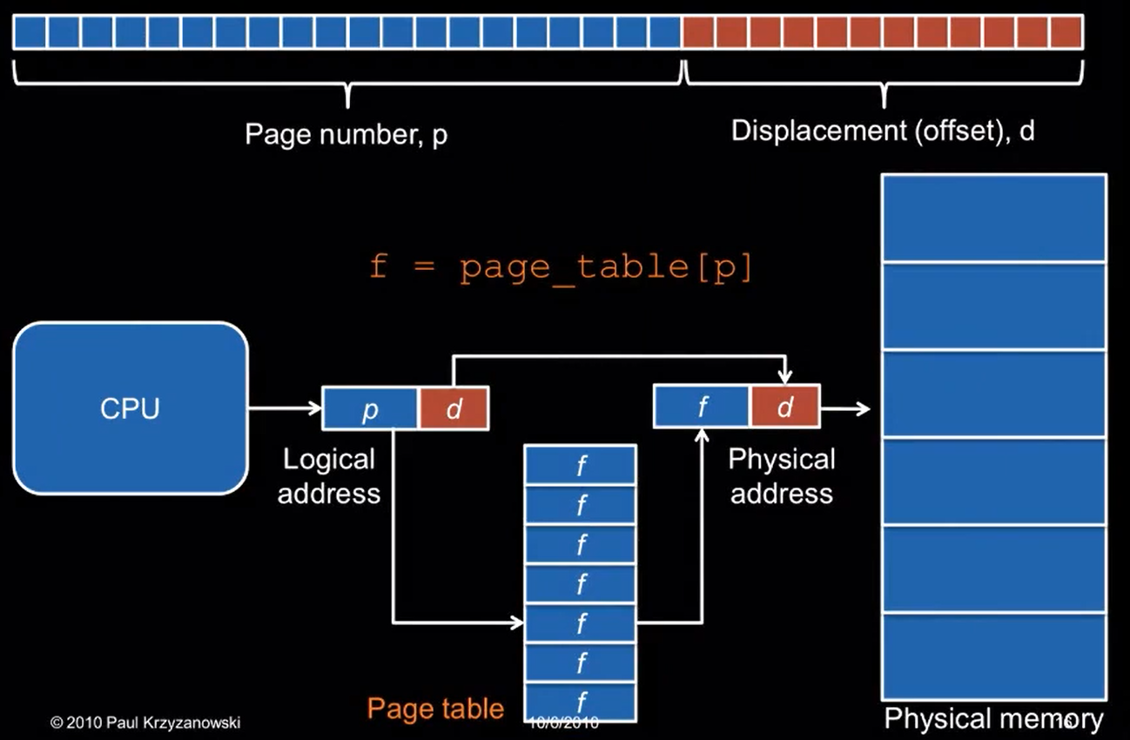
Page Translation

Slide 13
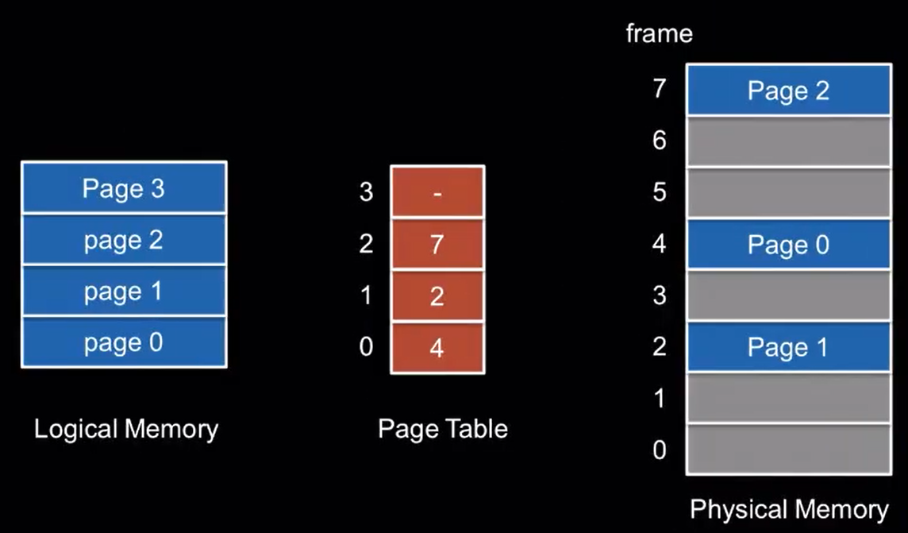
Logical vs. physical views of memory
Notes:
0---------01 = 20bits
0---------10 = 12bits Things to remember: 1. Segments are of not the same size
2. Paging are of equal size.
2.1. Remove the page number replace it with the frame number
Conversion of logical to physical address

Slide 14
Hardware Implementation
Where do you keep the page table? In memory
Each process gets its own virtual address space
Each process has its own page table
Change the page table by changing a page table base register
Memory translation is now slow!
To read a byte of memory, we need to read the page table first
Each memory access is now 2x slower!

Slide 15
Hardware Implementation: TLB
Cache frequently-accessed pages
Translation lookaside buffer (TLB)
Associative memory: Key (page #) and value (frame #)
TLB is on-chip (CPU) & fast ... But small (64-1,024 entries)
TLB miss: result not in the TLB
Need to do page table lookup in memory
Hit ratio = % of lookups that come from the TLB
Issue when we context switch
Notes:
Cache miss and Cache hit so we need to reduce the TLB miss RAM ---- Cache

Slide 16
Protection
An MMU can enforce memory protection
Page table stores protection bits per frame
Valid/invalid: is there a frame mapped to this page?
Read-only
No execute
Dirty
Notes:
We can solve big security issue using this concept

Slide 17
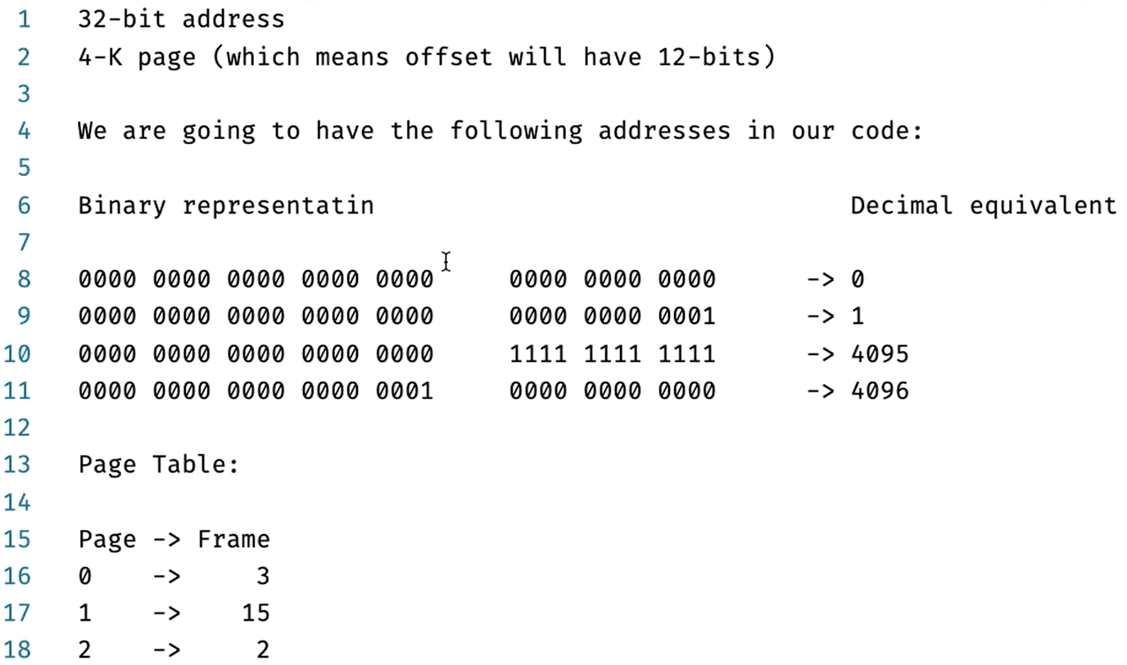
32 – bit address

Slide 18
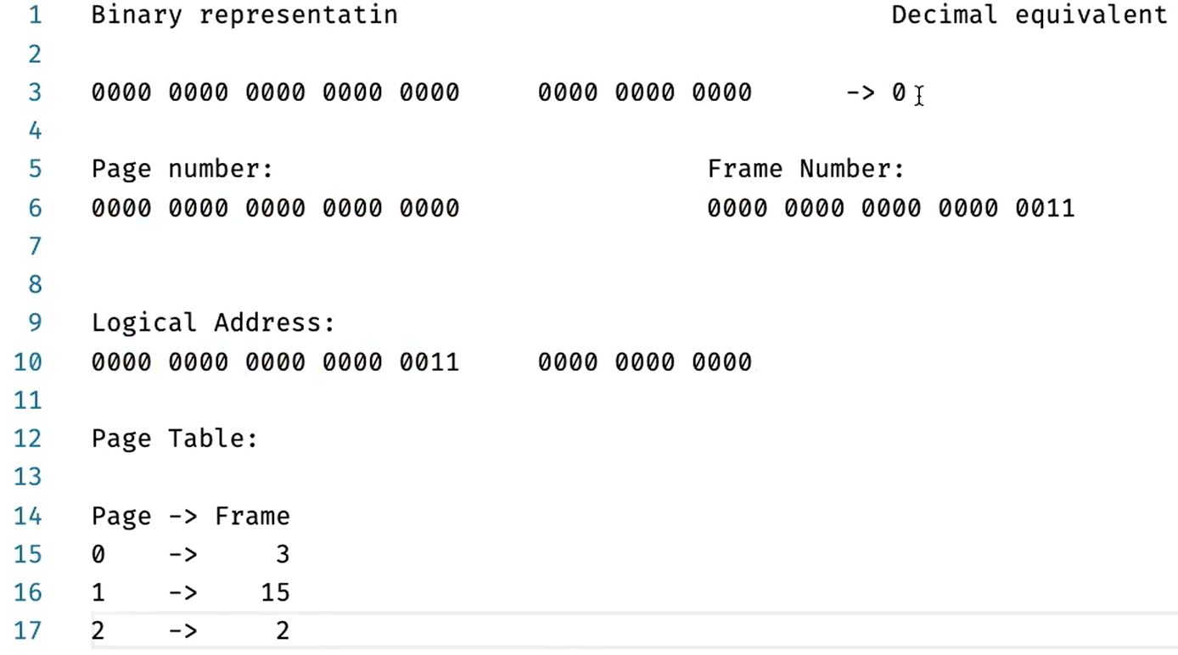
Binary Representation: Example # 1

Slide 19
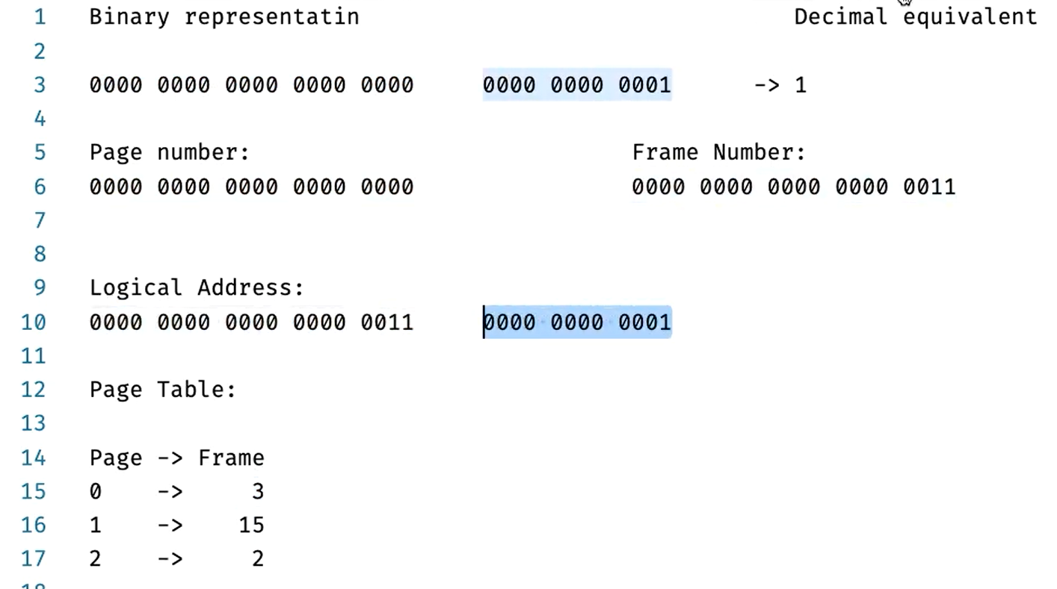
Binary Representation: Example 2

Slide 20
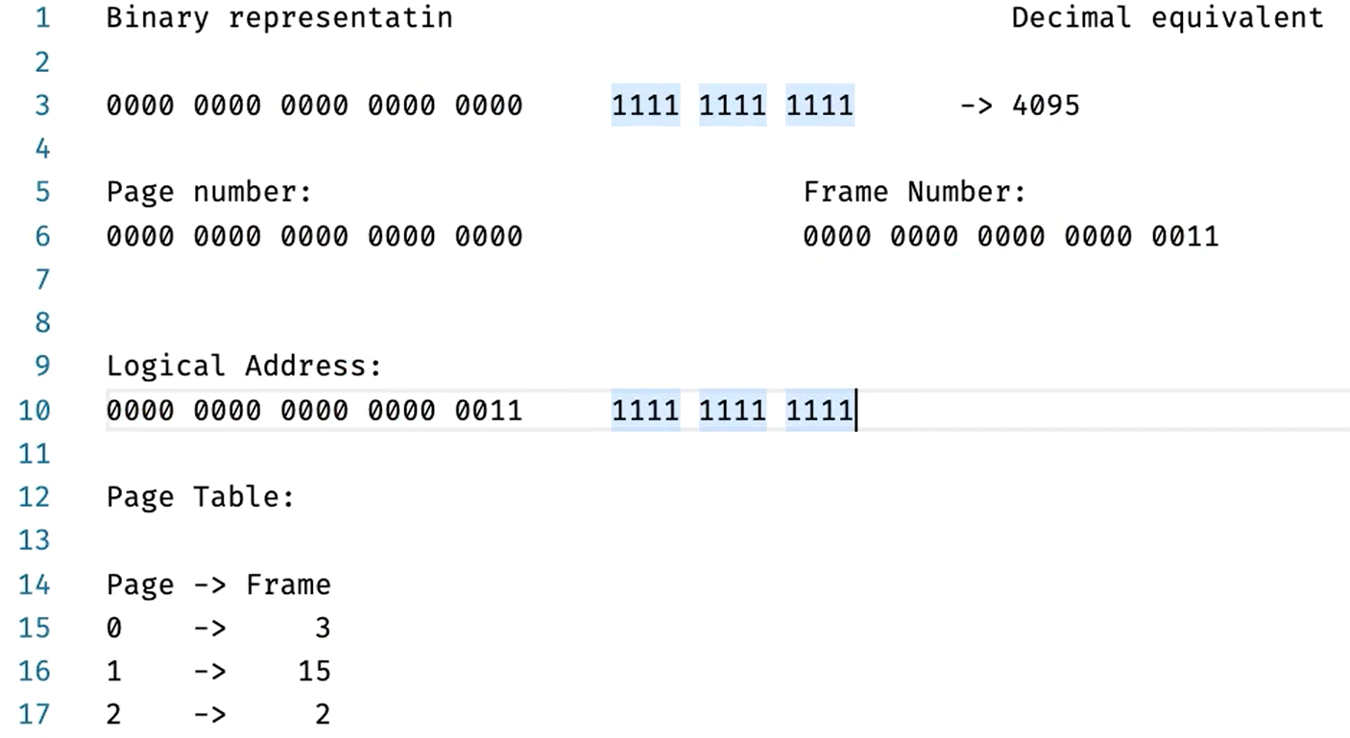
Binary Representation: Example # 3

Slide 21
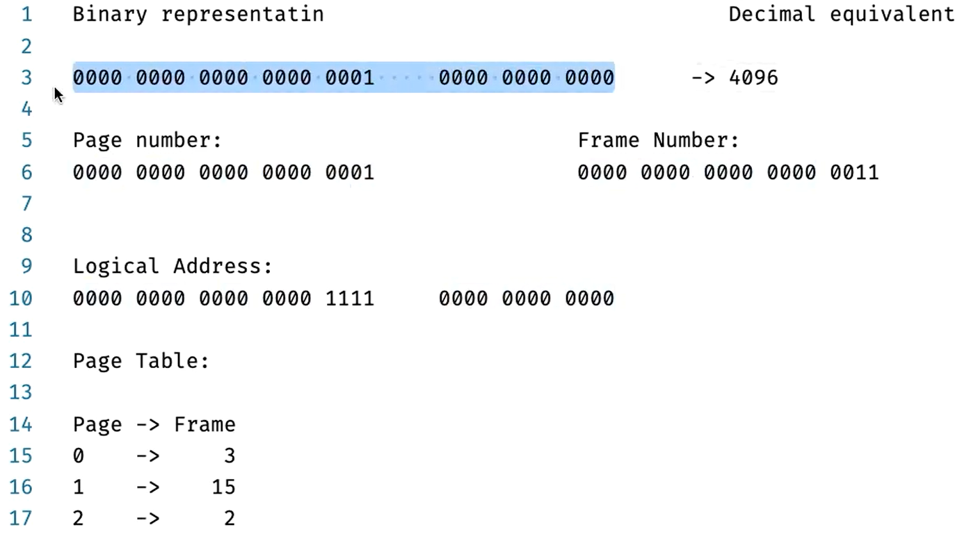
Binary Representation: Example 4

